Slide 1
Building Components using Swing and JavaFX
Prativa Nyaupane

Slide 2
Recap
Introduction to AWT and Swing:
Concept
Applets
Swing Class Hierarcy
Components/Containers
Layout Management

Slide 3
Today’s Objectives
GUI Controls
Menu Elements and Tooltips
Dialogs and Frames

Slide 4
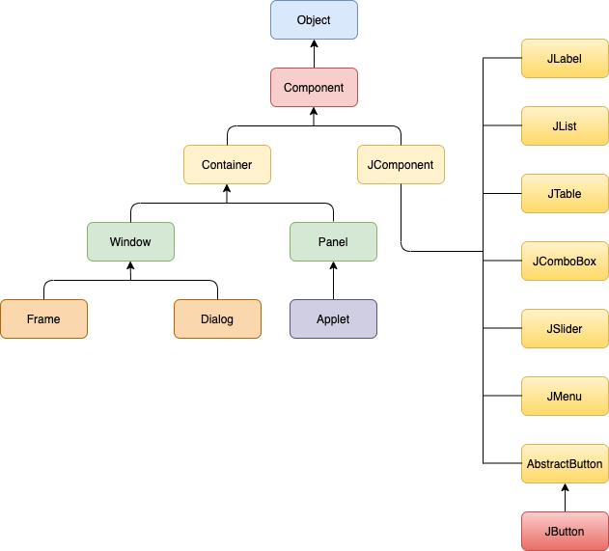
Swing Class Hierarchy
Java defines the class hierarchy for all the Swing Components.
Swing components are prefixed with the letter ‘J’
Key classes include JFrame, JPanel, JButton, JTextField..

Slide 5
GUI Controls
GUI Controls are also known as UI controls/components/visual elements.
These controls are often displayed within windows or dialog boxes.
Windows are rectangular area on the the screen than can contain components.
They are interactive elements that users can interact with.
These controls are building blocks of a GUI application.
They allow users to input data, make selections and trigger actions.
GUI controls are essential for creating interactive and user-friendly applications.

Slide 6
GUI Controls Contd…
Buttons: Triggers actions when clicked.
Text Fields: Allow users to input text.
Checkboxes: Enable users to make binary choices.
Radio Buttons: Provide options for exclusive selection.
Combo Boxes: Present a list of options for selection.
Sliders: Adjust values within a specified range.
List Boxes: Display a list of items for selection.

Slide 7
Menu Elements
Menus are a common UI pattern that organizes commands and options.
Menus provide a structured way to organize functionality, make it easily accessible to users.
Menu elements include:
Menu Bar: A horizontal bar containing menus.
Menu: A list of commands or options.
Menu Item: An individual option within a menu.
Submenu: A nested menu within another menu.

Slide 8
Tooltips
Tooltips are small informational pop-ups that appear when users hover over a UI element.
They provide brief descriptions or additional information about the associated element.

Slide 9
Dialogs
Dialogs are separate windows that prompt users for input, display information or request confirmation
Common types include:
Message Dialogs: Display messages to the user.
Input Dialogs: Prompt users for input.
File Choosers: Allow users to select files or directories.
Option Dialogs: Present a set of predefined options.
Dialogs are user for communication between the application and the user.
They provide a way to gather input, convey messages , or obtain user confirmation.

